Slide 1
Trace Completion for Datalog Program
Omar Briceño

Slide 2

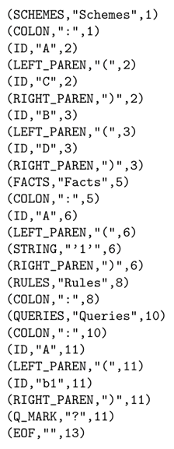
Trace
Datalog Pr.
Input
Schemes:
A(C)
B(D)
Facts:
A(‘1’)
Rules:
Queries:
A(b1)?

Slide 3
Trace
Stack
Input
Datalog()

Slide 4
Trace
Stack
Input
Datalog()

Slide 5
Trace
Stack
Input
Datalog()

Slide 6
Trace
Stack
Input
Datalog() scheme()

Slide 7
Trace
Stack
Input
Datalog() scheme()

Slide 8
Trace
Stack
Input
Datalog() scheme()

Slide 9
Trace
Stack
Input
Datalog() scheme() idList()

Slide 10
Trace
Stack
Input
Datalog() scheme()

Slide 11
Trace
Stack
Input
Datalog() scheme()

Slide 12
Trace
Stack
Input
Datalog() scheme()

Slide 13
Trace
Stack
Input
Datalog()

Slide 14
Trace
Stack
Input
Datalog() schemeList()

Slide 15
Trace
Stack
Input
Datalog() schemeList() scheme()

Slide 16
Trace
Stack
Input
Datalog() schemeList() scheme()

Slide 17
Trace
Stack
Input
Datalog() schemeList() scheme()

Slide 18
Trace
Stack
Input
Datalog() schemeList() scheme() idList()

Slide 19
Trace
Stack
Input
Datalog() schemeList() scheme()

Slide 20
Trace
Stack
Input
Datalog() schemeList() scheme()

Slide 21
Trace
Stack
Input
Datalog() schemeList() scheme()

Slide 22
Trace
Stack
Input
Datalog() schemeList()

Slide 23
Trace
Stack
Input
Datalog() schemeList() schemeList()

Slide 24
Trace
Stack
Input
Datalog() schemeList()

Slide 25
Trace
Stack
Input
Datalog()

Slide 26
Trace
Stack
Input
Datalog()

Slide 27
Trace
Stack
Input
Datalog()

Slide 28
Trace
Stack
Input
Datalog() factList()

Slide 29
Trace
Stack
Input
Datalog() factList()

Slide 30
Trace
Stack
Input
Datalog() factList() fact()

Slide 31
Trace
Stack
Input
Datalog() factList() fact()

Slide 32
Trace
Stack
Input
Datalog() factList() fact()

Slide 33
Trace
Stack
Input
Datalog() factList() fact() stringList()

Slide 34
Trace
Stack
Input
Datalog() factList() fact()

Slide 35
Trace
Stack
Input
Datalog() factList() fact()

Slide 36
Trace
Stack
Input
Datalog() factList() fact()

Slide 37
Trace
Stack
Input
Datalog() factList() fact() > expected PERIOD Throws token step number to get token info

